Slide 1
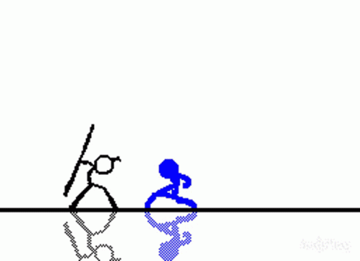
Census data slide
By oliver prebble and Haven Pangan
Tartarus

Slide 2
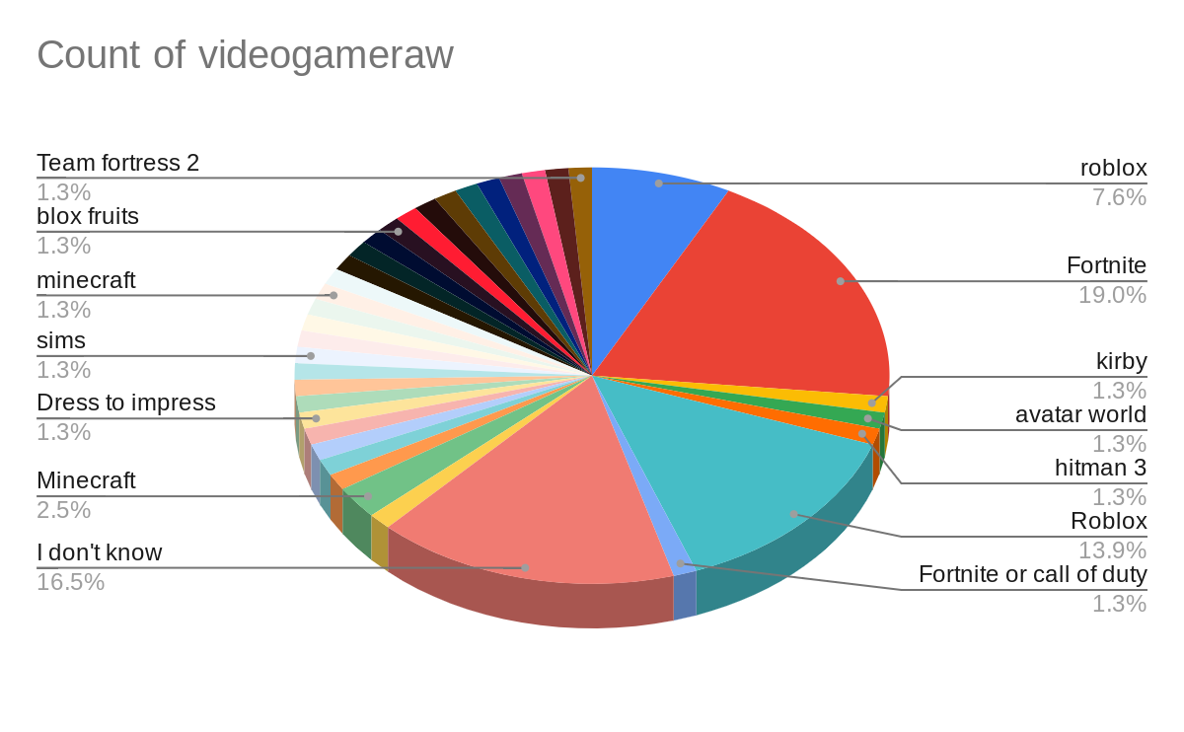
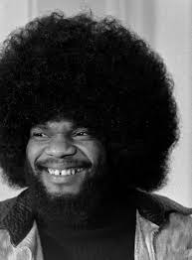
Video game data

Slide 3
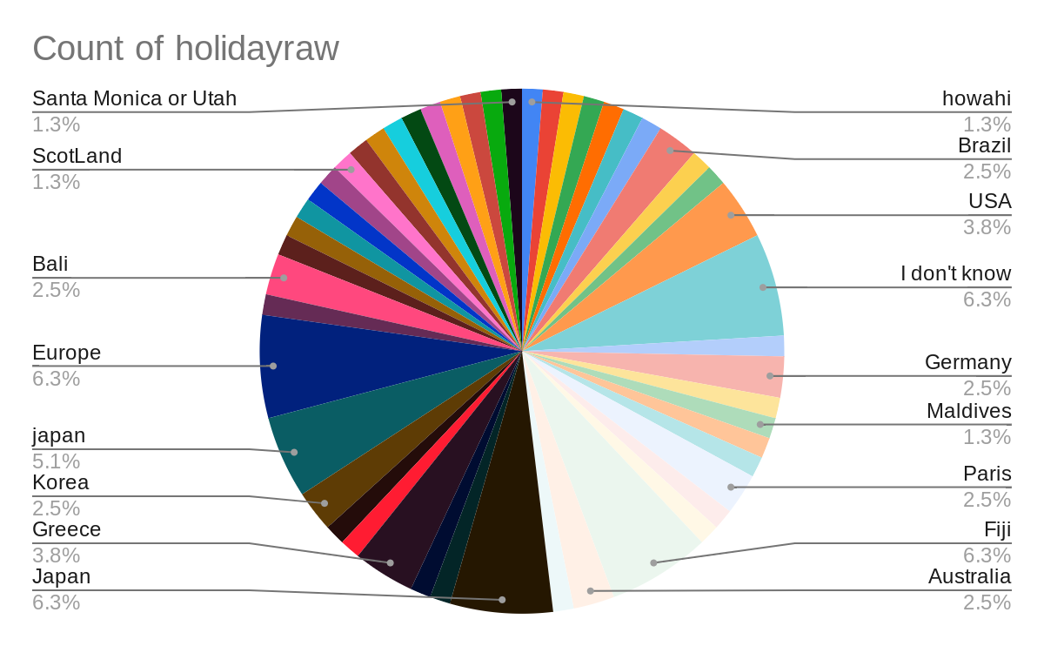
Holiday places

Slide 4
I wonder statements
I wonder what the most popular video game is.
I wonder what the most popular holiday place is.
I wonder what game is mostly played by the even numbered people.
I wonder what continent has the most people who want to go there.
I wonder what is the most unpopular game in the graph.

Slide 5
I notice statements
Fortnite is the most popular game
The 2 most popular holiday places are europe and japan.
I noticed that most people don’t know what their favorite game is.
Asia is the most popular continent to go to.
Every game that is 1.3% are thee least played games.

